Slide 1

Basic Details of the Team and Problem Statement
Ministry/Organisation Name/Student Innovation:
PS Code:SIH1633
Problem Statement Title: Intelligent platform to Interconnect Alumni and Student for Technical Education Department, Govt. of Rajasthan
Team Name: Codeicious Devx
Team Leader Name: Anirudh Prajapati (2022UEA6512)
Institute Code (AISHE):U-1058
Institute Name: Netaji Subhas University Of Technology
Theme Name:Smart Education

Slide 2
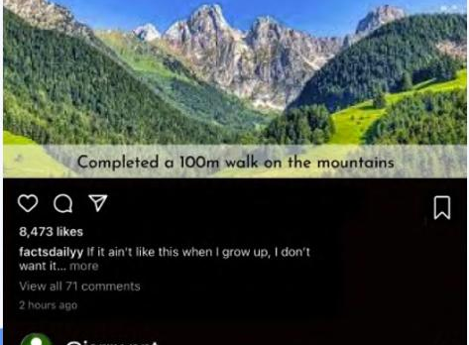
Idea/Approach Details
SOLUTION :
Alumni-Student Interaction Platform introduces users to a secure and intuitive experience, featuring AI-driven mentorship matching, a comprehensive alumni database, and vibrant community forums for networking and discussion. Key functionalities like personalized career guidance, direct messaging, and real-time notifications are highlighted, all aimed at fostering meaningful connections and collaboration between alumni and students. The platform emphasizes its commitment to security, inclusivity, and cross-device accessibility, ensuring every user benefits from a seamless and engaging experience.
Technology Stack :
Frontend :- Reactjs , tailwindcss , Framer
Backend :- Nodejs ,Expressjs
DataBase :- Firebase(Firestore)

Slide 3
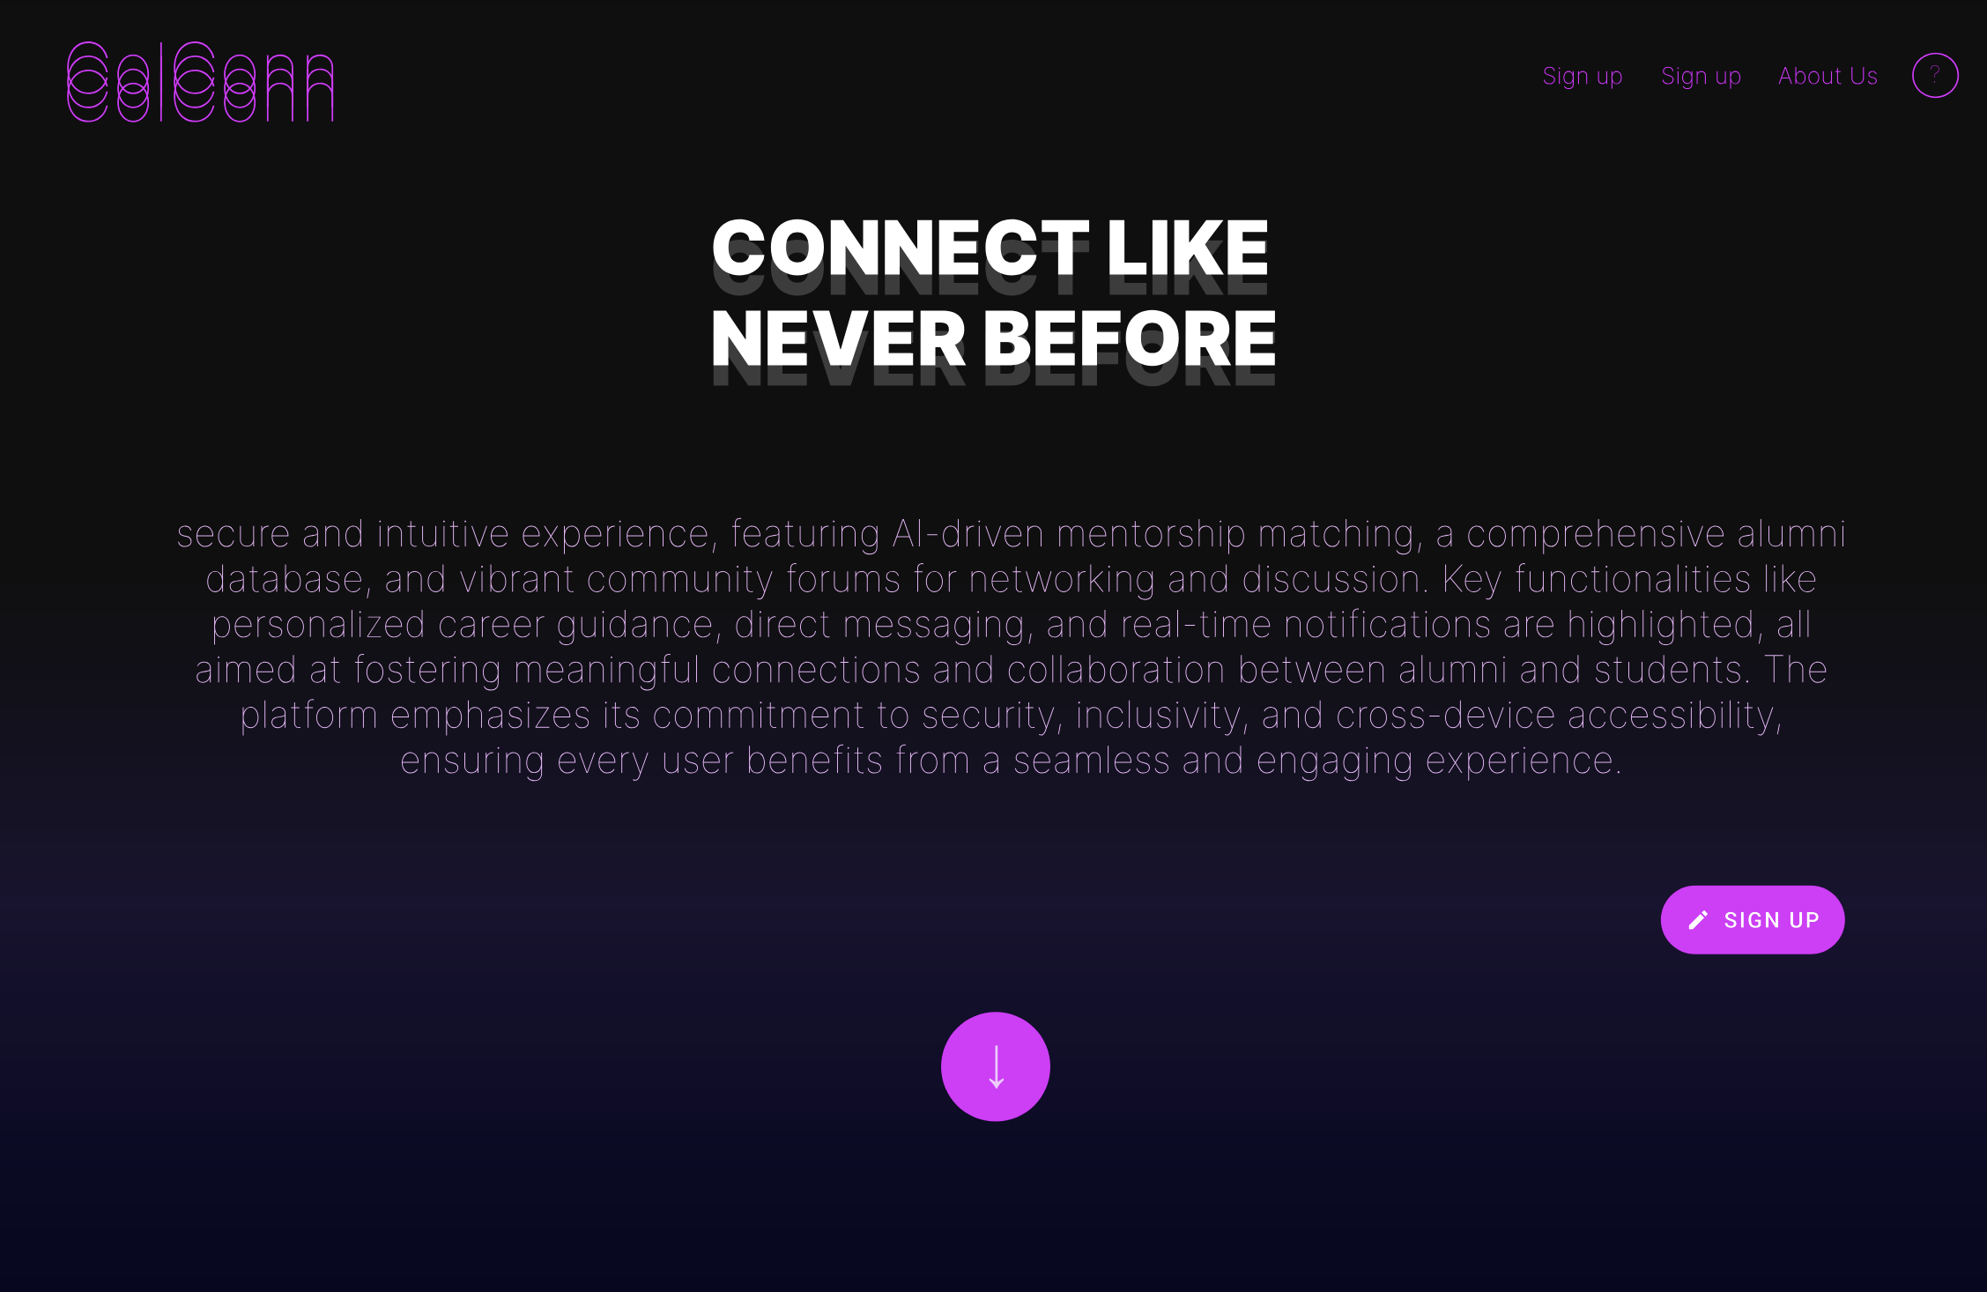
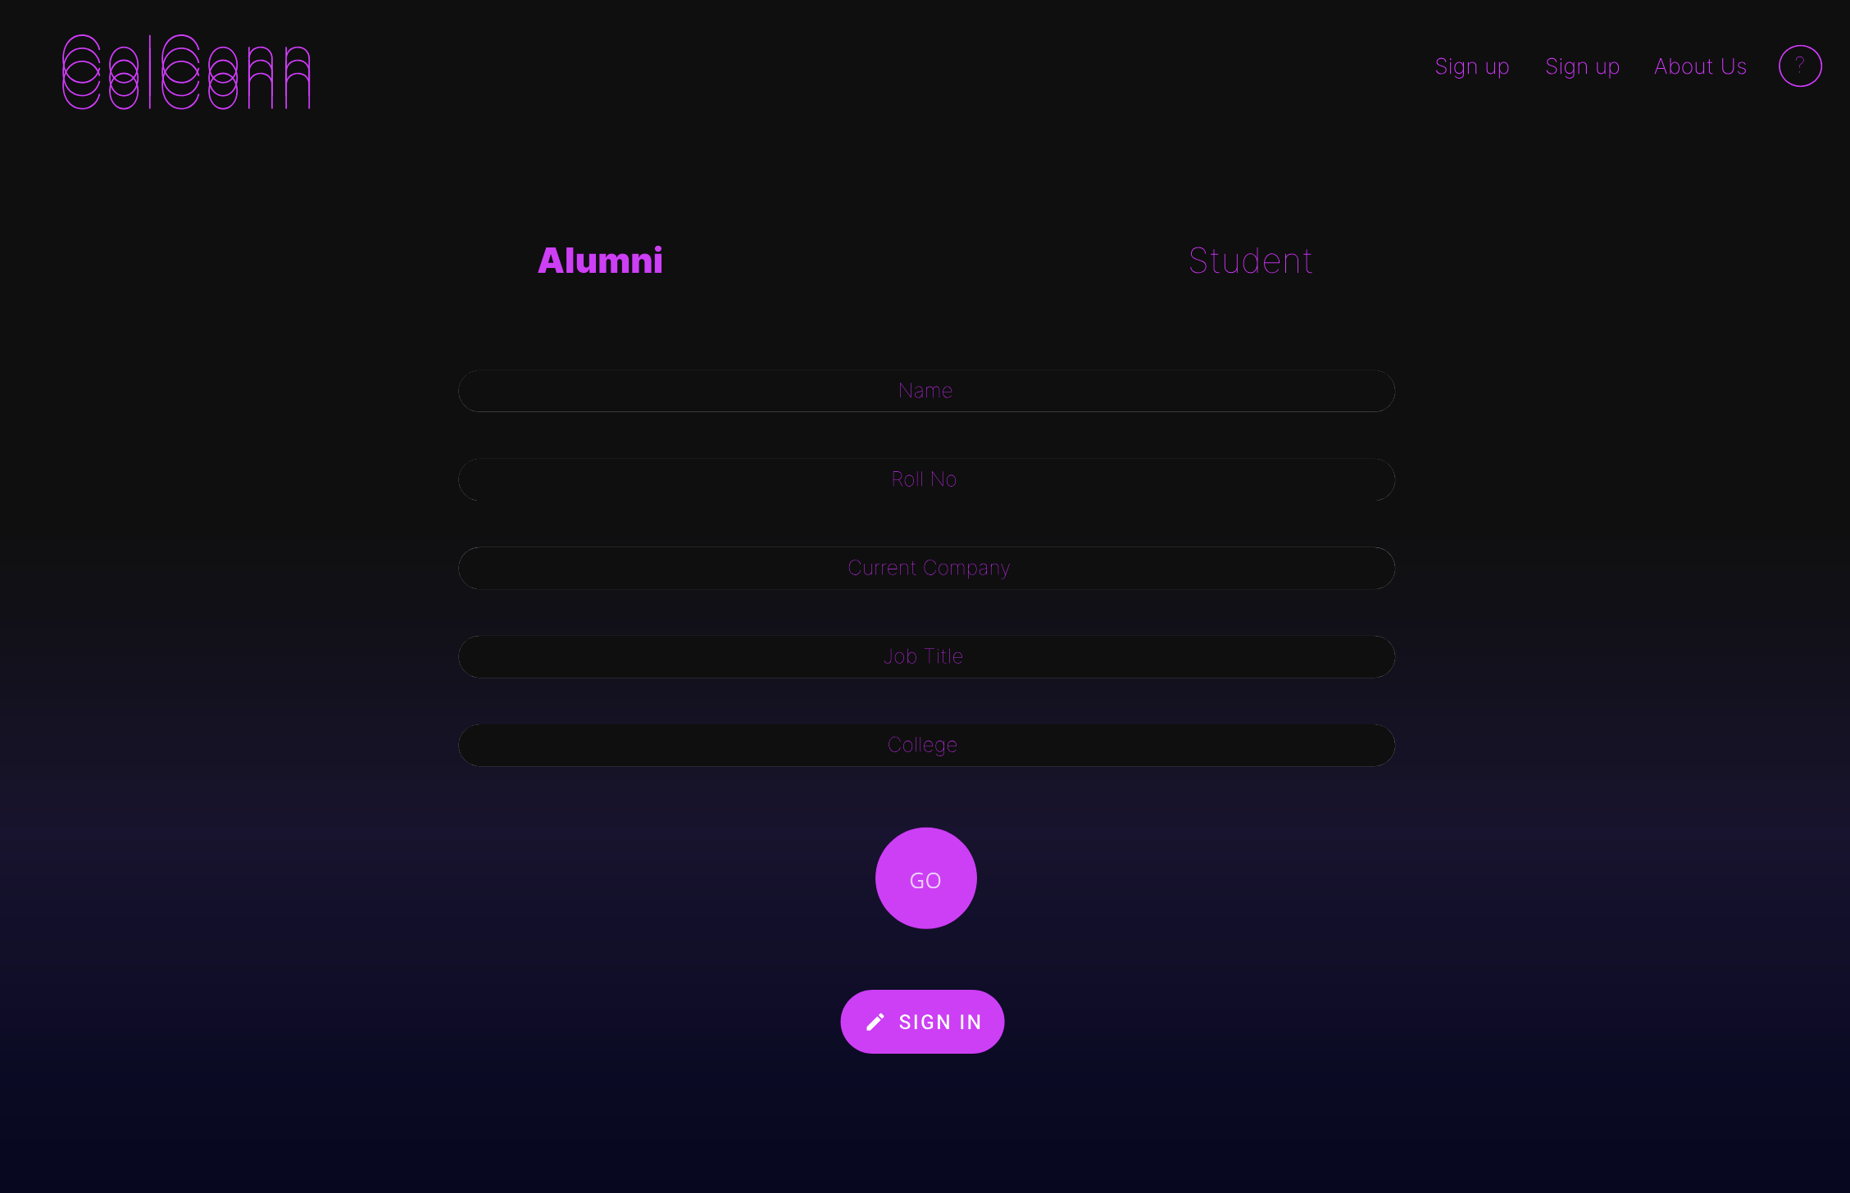
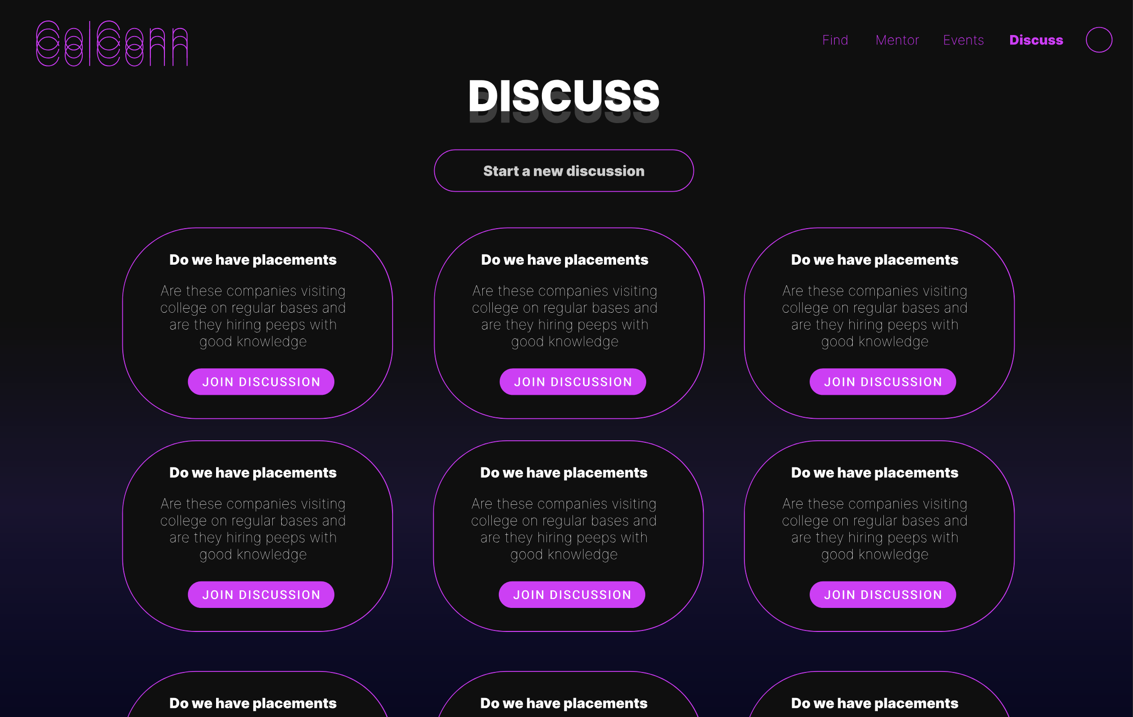
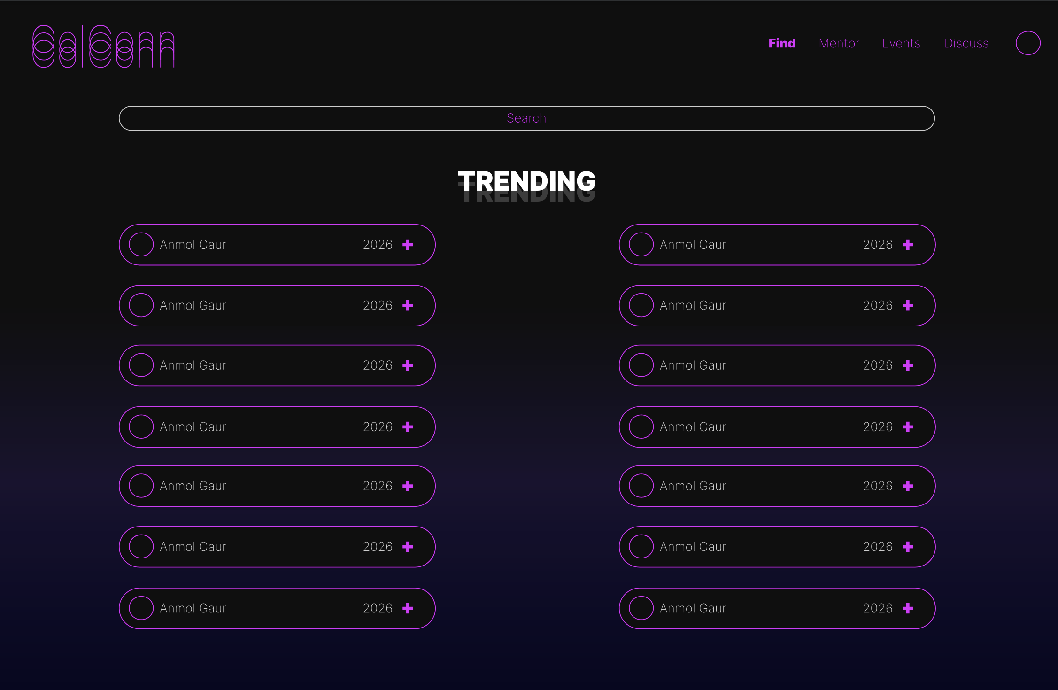
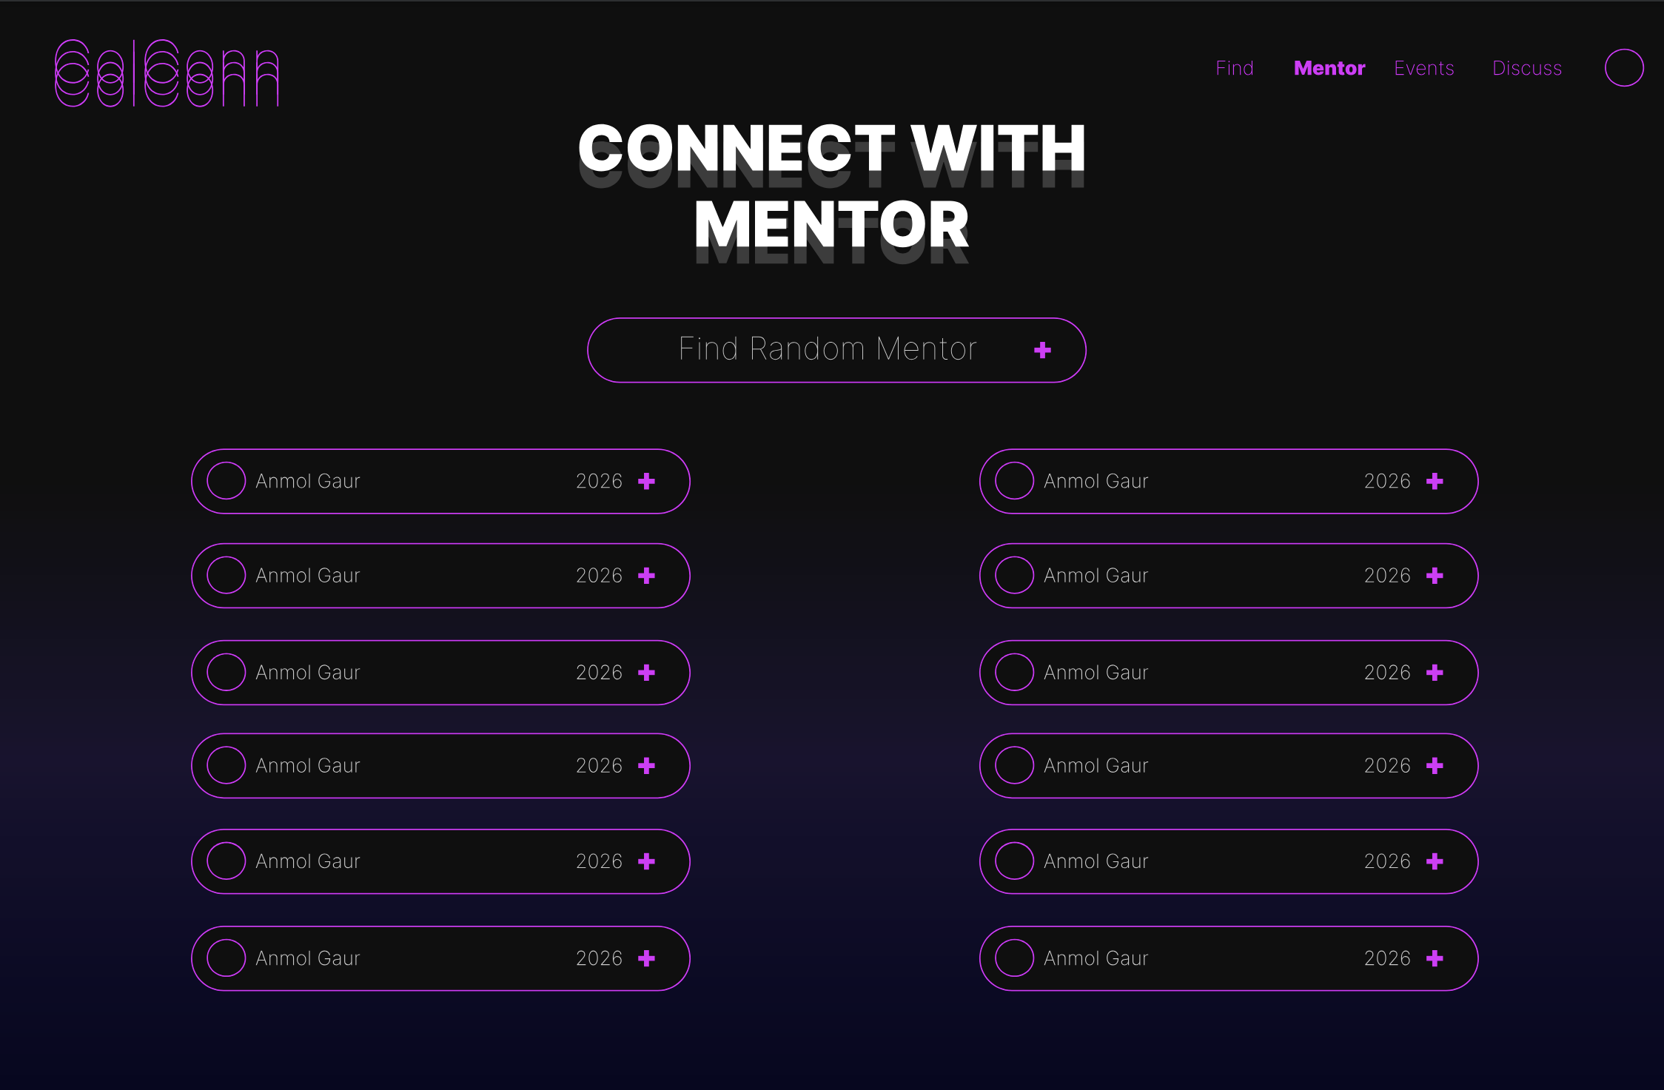
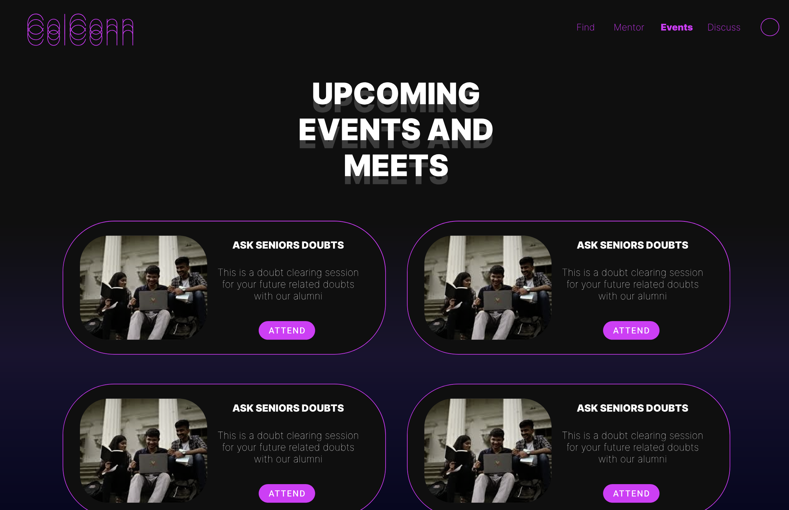
WEBSITE

Slide 4
Idea/Approach Details
Vision:
The vision of the Alumni-Student Interaction Platform is to create a secure and user-friendly space that connects alumni and students, enabling meaningful interactions through mentorship and community engagement. By offering essential features like an alumni database and personalized guidance, the platform aims to support lifelong connections and professional growth. Our commitment is to provide an inclusive and accessible experience that fosters collaboration and learning across all devices.
Target audience:
Our Target audience are the college going students who want to connect with alumnis to network and explore opportunities

Slide 5
Team Member Details
Team Leader Name: Anirudh Prajapati ( 2022UEA6512 )
Branch (B tech): Electronics and Communication (Artificial Intelligence and Machine Learning) Year (III)
Team Member 1 Name: Ojas Sharma ( 2022UEA6517 )
Branch (B tech): Electronics and Communication (Artificial Intelligence and Machine Learning) Year (III)
Team Member 2 Name: Samarth Mishra ( 2022UEA6545 )
Branch (B tech): Electronics and Communication (Artificial Intelligence and Machine Learning) Year (III)
Team Member 3 Name: Anmol Gaur ( 2022UCI6503 )
Branch (B tech): Computer science (Internet Of Things)
Year (III)
Team Member 4 Name: Piyush Kushwaha( 2022UEA6551)
Branch (B tech): Electronics and Communication (Artificial Intelligence and Machine Learning) Year (III)
Team Member 5 Name: Vidooshi Sharma( 2022UEA6561 )
Branch (B tech): Electronics and Communication (Artificial Intelligence and Machine Learning) Year (III)

